Slide 1
A quick overview of Scale Creation

Slide 2
Agenda for Today
Overview of Psychometrics
Steps of Scale Creation*
Construct Conceptualization / Definition
Operationalizing the Construct
Evidence to Confirm Construct Validity
*Following Lambert & Newman (2022)

Slide 3
Before We Begin

Slide 4
Analysis Software
I will be using R-Studio for my examples (found here)
R-Studio is a GUI overlay that makes R much easier to use
You will also need to download the base R software to run R-Studio (found here)
I will be using a few different example datasets…
Lets set them up!

Slide 5
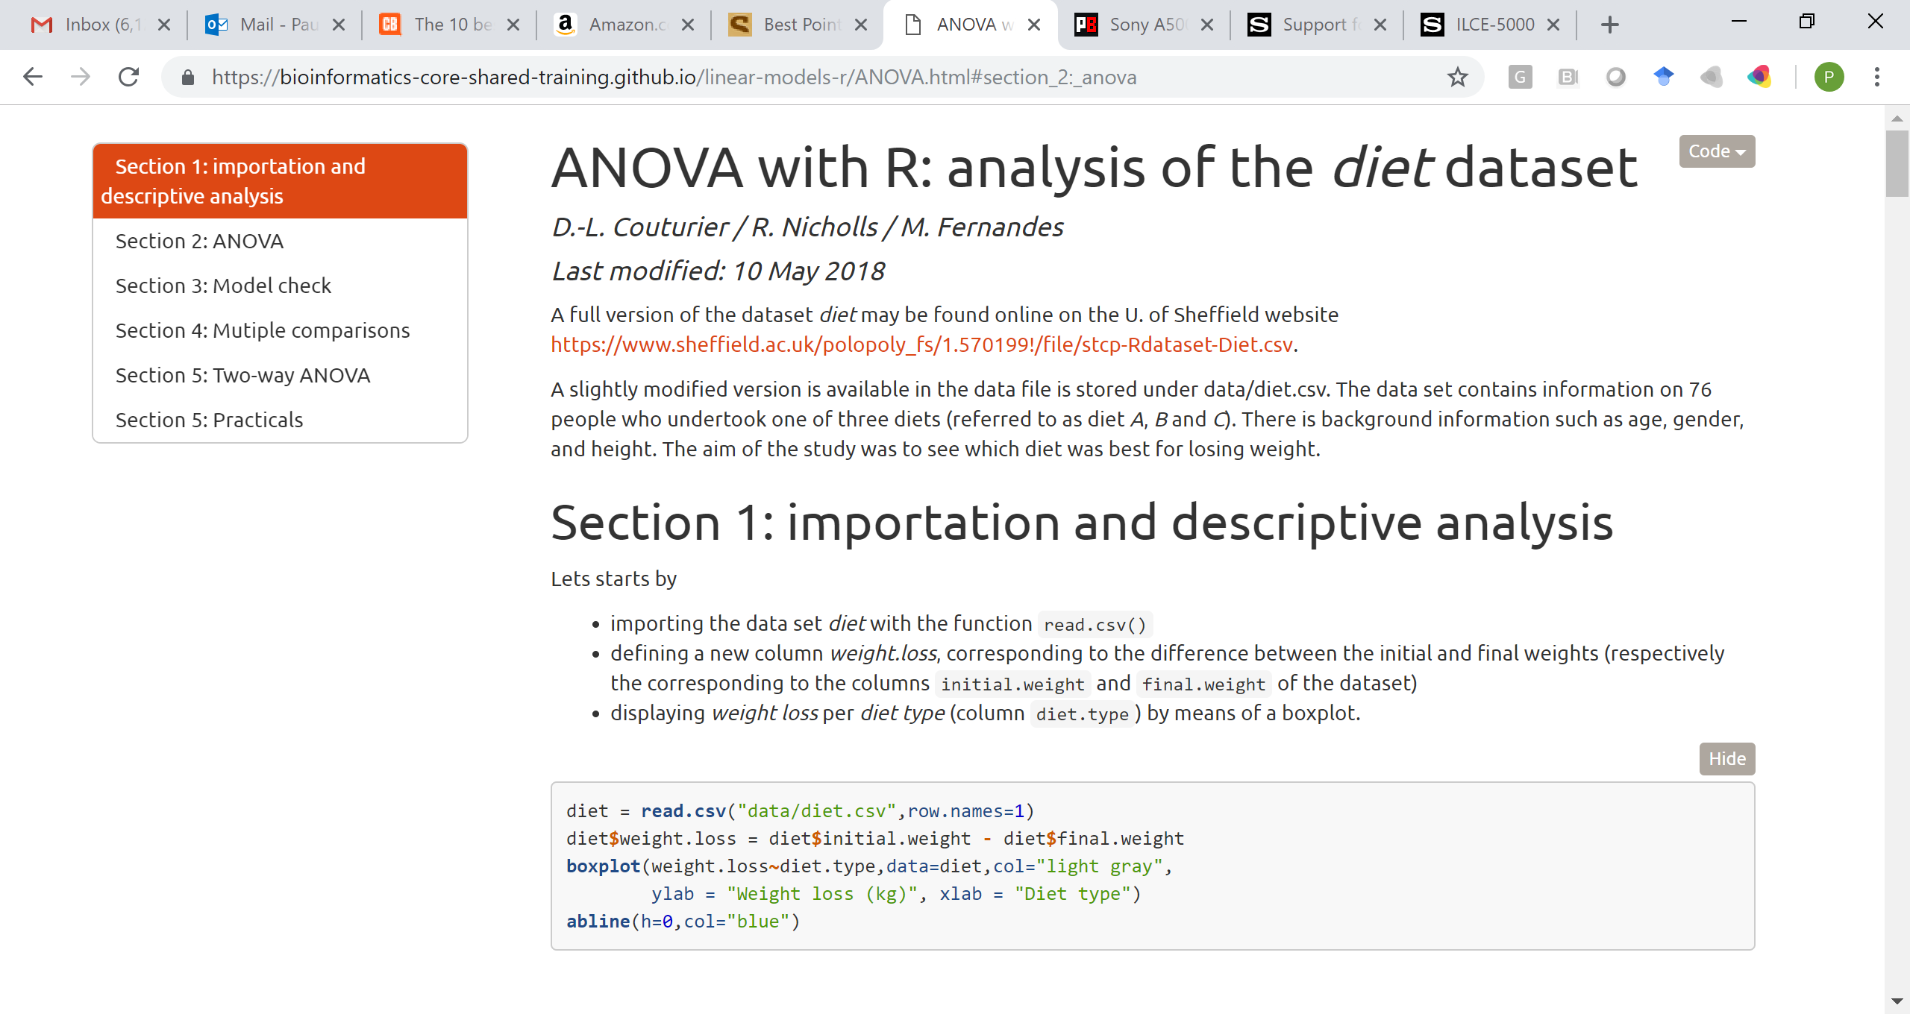
Example Data Set - Diet
https://bioinformatics-core-shared-training.github.io/linear-models-r/anova.html
UPDATE
Diet Dataset

Slide 6
Example Data Set - Diet
EXPLAIN DATA
Copy Data to Excel from Comment Here
UPDATE
Diet Dataset

Slide 7
Example Data Set - Diet
Import and Clean Up the Data
> Import<-read.delim(file="clipboard") #Reads data in from the clipboard
> dat<-na.omit(Import) #Delete Any Missing Values
> names(dat) #Returns the column names in the dataset
[1] "Person" "gender" "Age" "Height" "pre.weight"
[6] "Diet" "weight6weeks"
> aggregate(diet$Diet,list(diet$Diet,diet$gender),length) #Return N per Cell
Group.1 Group.2 x
1 1 0 14
2 2 0 14
3 3 0 15
4 1 1 10
5 2 1 11
6 3 1 12
# could also use xtabs(~Diet+gender,diet)
UPDATE
Diet Dataset

Slide 8
Example Data Set - Diet
Import and Clean Up the Data
> Import<-read.delim(file="clipboard") #Reads data in from the clipboard
> diet<-na.omit(Import) #Delete Any Missing Values
> names(diet) #Returns the column names in the dataset
[1] "Person" "gender" "Age" "Height" "pre.weight"
[6] "Diet" "weight6weeks"
> aggregate(diet$Diet,list(diet$Diet,diet$gender),length) #Return N per Cell
Group.1 Group.2 x
1 1 0 14
2 2 0 14
3 3 0 15
4 1 1 10
5 2 1 11
6 3 1 12
# could also use xtabs(~Diet+gender,diet)
UPDATE
Diet Dataset
What do we notice here?

Slide 9
Example Data Set - Diet
For our example, we can randomly select individuals so we have equal numbers in the male and female groups
#Create a new variable that just pastes together Diet and gender
diet$d.g<-paste(diet$Diet,diet$gender,sep=".")
diet$d.g[1:20]
#Set up code to randomly sample 10 d.g values
#logic of code is to only select Person IDs that match
#the 10 Person IDs sampled from each d.g group using tapply
set.seed(4543556) #Setting the seed makes it so we always get the same result
diet.dat<-diet[diet$Person%in%unlist(tapply(diet$Person,diet$d.g,sample,10)),]
aggregate(diet.dat$Diet,list(diet.dat$Diet,diet.dat$gender),length)
UPDATE
Diet Dataset

Slide 10
Overview of Psychometrics

Slide 11
Overview of Psychometrics
What are we trying to do with scales?
How do we measure something
we cannot see?
What was that weird French guy talking about before he concluded “I think, therefore I am?”

Slide 14
What is this tiny dot?

Slide 15
Latent Construct
What happens when we bring the latent construct into the “real world”?
Are we able to see it?
What can we see?

Slide 16
Behavior₈
Latent Construct
Behavior₃
Behavior₁
Behavior₄
Behavior₇
Behavior₅
Behavior₂
Behavior₆

Slide 17
Latent Construct
Behavior₁
Behavior₂
Behavior₃
Behavior₄
Behavior₅
Behavior₆
Behavior₇
Behavior₈

Slide 18
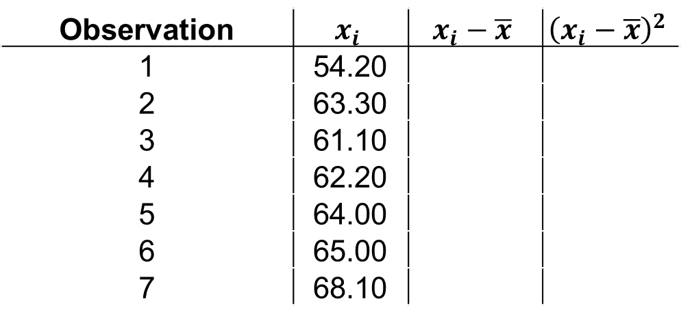
Foundations of Statistical Analysis
What is variance?
What does variance look like in real data?
Observation | $$x_{i}$$ | $$x_{i}−\overline{x}$$ | $${\left(x_{i}−\overline{x}\right)}^{2}$$
1 | 54.20
2 | 63.30
3 | 61.10
4 | 62.20
5 | 64.00
6 | 65.00
7 | 68.10
Diet Dataset
diet.dat[1:7,c("weight6weeks")] # returns xi
mean(diet.dat[1:7,c("weight6weeks")]) # returns xbar

Slide 19

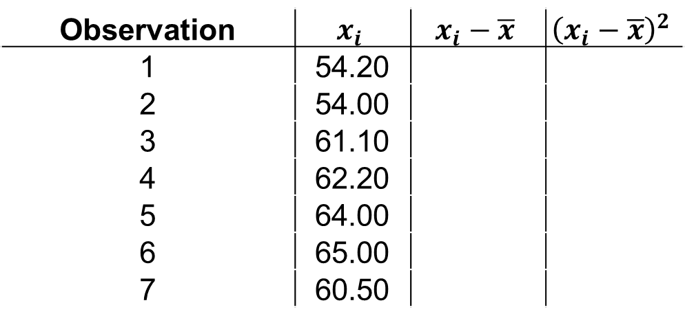
Foundations of Statistical Analysis
What is variance?
What does variance look like in real data?
Observation | $$x_{i}$$ | $$x_{i}−\overline{x}$$ | $${\left(x_{i}−\overline{x}\right)}^{2}$$
1 | 54.20
2 | 54.00
3 | 61.10
4 | 62.20
5 | 64.00
6 | 65.00
7 | 60.50
$\overline{x}$= 60.14
Diet Dataset
diet.dat[1:7,c("weight6weeks")] # returns xi
mean(diet.dat[1:7,c("weight6weeks")]) # returns xbar

Slide 20
Foundations of Statistical Analysis
What is variance?
What does variance look like in real data?
Observation | $$x_{i}$$ | $$x_{i}−\overline{x}$$ | $${\left(x_{i}−\overline{x}\right)}^{2}$$
1 | 54.20
2 | 63.30
3 | 61.10
4 | 62.20
5 | 64.00
6 | 65.00
7 | 68.10
Diet Dataset
63

Slide 21
Foundations of Statistical Analysis
What is variance?
What does variance look like in real data?
Observation | $$x_{i}$$ | $$x_{i}−\overline{x}$$ | $${\left(x_{i}−\overline{x}\right)}^{2}$$
1 | 54.20
2 | 63.30
3 | 61.10
4 | 62.20
5 | 64.00
6 | 65.00
7 | 68.10
x
Diet Dataset
63

Slide 22
Foundations of Statistical Analysis
What is variance?
What does variance look like in real data?
Observation | $$x_{i}$$ | $$x_{i}−\overline{x}$$ | $${\left(x_{i}−\overline{x}\right)}^{2}$$
1 | 54.20
2 | 63.30
3 | 61.10
4 | 62.20
5 | 64.00
6 | 65.00
7 | 68.10
x
Diet Dataset
54
57
63
69
72

Slide 23
Foundations of Statistical Analysis
What is variance?
What does variance look like in real data?
Observation | $$x_{i}$$ | $$x_{i}−\overline{x}$$ | $${\left(x_{i}−\overline{x}\right)}^{2}$$
1 | 54.20
2 | 63.30
3 | 61.10
4 | 62.20
5 | 64.00
6 | 65.00
7 | 68.10
x
x
x
x
x
x
x
x
Diet Dataset
54
57
63
69
72

Slide 24
Foundations of Statistical Analysis
What is variance?
What does variance look like in real data?
Observation | $$x_{i}$$ | $$x_{i}−\overline{x}$$ | $${\left(x_{i}−\overline{x}\right)}^{2}$$
1 | 54.20
2 | 63.30
3 | 61.10
4 | 62.20
5 | 64.00
6 | 65.00
7 | 68.10
The “spread” of the data
x
x
x
x
x
x
x
x
Diet Dataset
54
57
63
69
72

Slide 25
Foundations of Statistical Analysis
What is variance?
Lets calculate the variance
Observation | $$x_{i}$$ | $$x_{i}−\overline{x}$$ | $${\left(x_{i}−\overline{x}\right)}^{2}$$
1 | 54.20
2 | 63.30
3 | 61.10
4 | 62.20
5 | 64.00
6 | 65.00
7 | 68.10
Diet Dataset

Slide 26
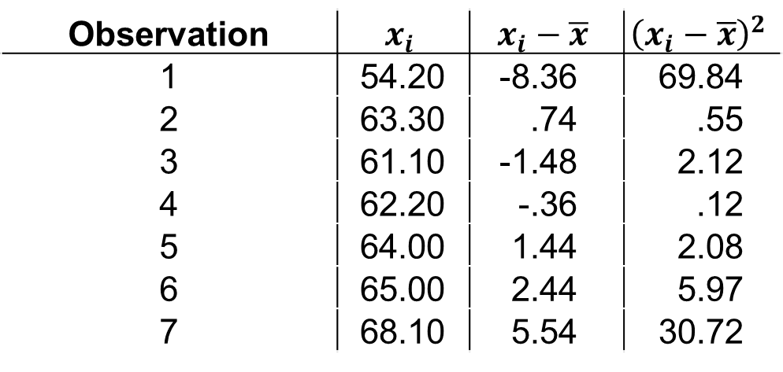
Foundations of Statistical Analysis
What is variance?
Fill in the table
Observation | $$x_{i}$$ | $$x_{i}−\overline{x}$$ | $${\left(x_{i}−\overline{x}\right)}^{2}$$
1 | 54.20 | -8.36 | 69.84
2 | 63.30 | .74 | .55
3 | 61.10 | -1.48 | 2.12
4 | 62.20 | -.36 | .12
5 | 64.00 | 1.44 | 2.08
6 | 65.00 | 2.44 | 5.97
7 | 68.10 | 5.54 | 30.72
Diet Dataset
diet.dat[1:7,c("weight6weeks")]-mean(diet.dat[1:7,c("weight6weeks")]) # returns xi-xbar
(diet.dat[1:7,c("weight6weeks")]-mean(diet.dat[1:7,c("weight6weeks")]))^2 # returns (xi-xbar)^2

Slide 27
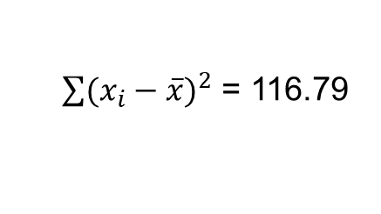
Foundations of Statistical Analysis
What is variance?
Calculate the sum of square differences
Observation | $$x_{i}$$ | $$x_{i}−\overline{x}$$ | $${\left(x_{i}−\overline{x}\right)}^{2}$$
1 | 54.20 | -8.36 | 69.84
2 | 63.30 | .74 | .55
3 | 61.10 | -1.48 | 2.12
4 | 62.20 | -.36 | .12
5 | 64.00 | 1.44 | 2.08
6 | 65.00 | 2.44 | 5.97
7 | 68.10 | 5.54 | 30.72
$\sum{{(x_{i}−\overline{x})}^{2}}$ = 116.79
Diet Dataset
# Calculate the sum of the squared differences
sum((diet.dat[1:7,c("weight6weeks")]-mean(diet.dat[1:7,c("weight6weeks")]))^2)

Slide 28

Foundations of Statistical Analysis
What is variance?
Adjust for the sample size
Observation | $$x_{i}$$ | $$x_{i}−\overline{x}$$ | $${\left(x_{i}−\overline{x}\right)}^{2}$$
1 | 54.20 | -8.36 | 69.84
2 | 63.30 | .74 | .55
3 | 61.10 | -1.48 | 2.12
4 | 62.20 | -.36 | .12
5 | 64.00 | 1.44 | 2.08
6 | 65.00 | 2.44 | 5.97
7 | 68.10 | 5.54 | 30.72
$\frac{\sum{{(x_{i}−\overline{x})}^{2}}}{n−1}$= 3.17
Diet Dataset
# Adjust for sample size (n-1)
sum((diet.dat[1:7,c("weight6weeks")]-mean(diet.dat[1:7,c("weight6weeks")]))^2)/(7-1)

Slide 29


Foundations of Statistical Analysis
What is variance?
Does this compare to the full dataset variance?
Our calculation:
Observation | $$x_{i}$$ | $$x_{i}−\overline{x}$$ | $${\left(x_{i}−\overline{x}\right)}^{2}$$
1 | 54.20 | -8.36 | 69.84
2 | 63.30 | .74 | .55
3 | 61.10 | -1.48 | 2.12
4 | 62.20 | -.36 | .12
5 | 64.00 | 1.44 | 2.08
6 | 65.00 | 2.44 | 5.97
7 | 68.10 | 5.54 | 30.72
$\frac{\sum{{(x_{i}−\overline{x})}^{2}}}{n−1}$= 18.57
R’s calculation:
Diet Dataset
$\frac{\sum{{(x_{i}−\overline{x})}^{2}}}{n−1}$= 65.50
# base-R calculation of variance
var(diet.dat$weight6weeks)

Slide 30
Foundations of Statistical Analysis
What is variance?
Does this compare to the full dataset variance?
Our calculation:
Observation | $$x_{i}$$ | $$x_{i}−\overline{x}$$ | $${\left(x_{i}−\overline{x}\right)}^{2}$$
1 | 54.20 | -8.36 | 69.84
2 | 63.30 | .74 | .55
3 | 61.10 | -1.48 | 2.12
4 | 62.20 | -.36 | .12
5 | 64.00 | 1.44 | 2.08
6 | 65.00 | 2.44 | 5.97
7 | 68.10 | 5.54 | 30.72
$\frac{\sum{{(x_{i}−\overline{x})}^{2}}}{n−1}$= 18.57
WTF?
R’s calculation:
Diet Dataset
$\frac{\sum{{(x_{i}−\overline{x})}^{2}}}{n−1}$= 65.50
# base-R calculation of variance
var(diet.dat$weight6weeks)

Slide 31

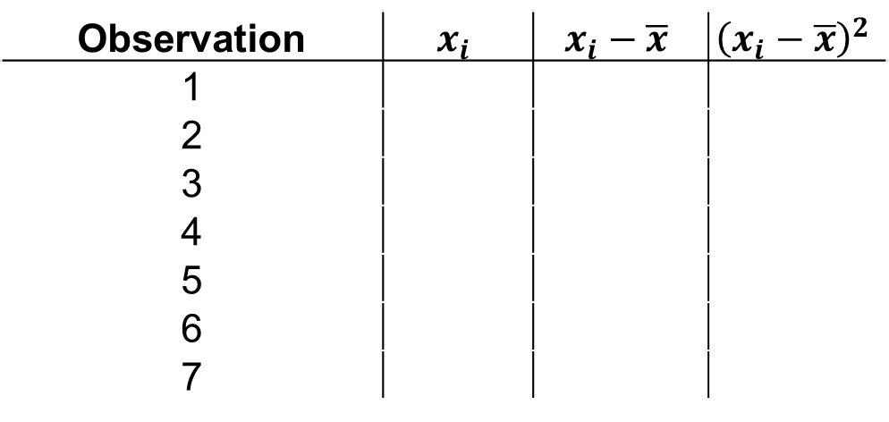
Foundations of Statistical Analysis
What is variance?
What does variance look like in real data?
dat$EmoLab # returns xi
mean(dat$EmoLab) # returns xbar
Observation | $$x_{i}$$ | $$x_{i}−\overline{x}$$ | $${\left(x_{i}−\overline{x}\right)}^{2}$$
1
2
3
4
5
6
7
$\overline{x}$ = ???
Class Dataset

Slide 32





Foundations of Statistical Analysis
What is variance?
What does variance look like in real data?
Observation | $$x_{i}$$ | $$x_{i}−\overline{x}$$ | $${\left(x_{i}−\overline{x}\right)}^{2}$$
1
2
3
4
5
6
7
x
Class Dataset
$$x_{i}$$
$$x_{i}$$
$$\overline{x}$$
$$x_{i}$$
$$x_{i}$$

Slide 33
Foundations of Statistical Analysis
What is variance?
Fill in the table
dat$EmoLab-mean(dat$EmoLab) # returns xi-xbar
(dat$EmoLab-mean(dat$EmoLab))^2 # returns (xi-xbar)^2
Observation | $$x_{i}$$ | $$x_{i}−\overline{x}$$ | $${\left(x_{i}−\overline{x}\right)}^{2}$$
1
2
3
4
5
6
7
Class Dataset

Slide 34
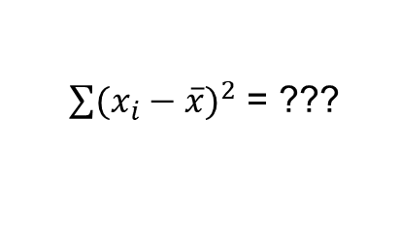
Foundations of Statistical Analysis
What is variance?
Calculate the sum of square differences
# Calculate the sum of the squared differences
sum((dat$EmoLab-mean(dat$EmoLab))^2)
Observation | $$x_{i}$$ | $$x_{i}−\overline{x}$$ | $${\left(x_{i}−\overline{x}\right)}^{2}$$
1
2
3
4
5
6
7
Class Dataset
$\sum{{(x_{i}−\overline{x})}^{2}}$ = ???

Slide 35

Foundations of Statistical Analysis
What is variance?
Adjust for the sample size
# Adjust for sample size (n-1)
sum((dat$EmoLab-mean(dat$EmoLab))^2)/(nrow(dat)-1)
Observation | $$x_{i}$$ | $$x_{i}−\overline{x}$$ | $${\left(x_{i}−\overline{x}\right)}^{2}$$
1
2
3
4
5
6
7
Class Dataset
$\frac{\sum{{(x_{i}−\overline{x})}^{2}}}{n−1}$= ???

Slide 36


Foundations of Statistical Analysis
What is variance?
But…
# Does this compare to our simulated data?
var(sim.dat$EmoLab)
Observation | $$x_{i}$$ | $$x_{i}−\overline{x}$$ | $${\left(x_{i}−\overline{x}\right)}^{2}$$
1
2
3
4
5
6
7
Our calculation:
$\frac{\sum{{(x_{i}−\overline{x})}^{2}}}{n−1}$= ???
Class Dataset
Simulation calculation:
$\frac{\sum{{(x_{i}−\overline{x})}^{2}}}{n−1}$= ???

Slide 37
Foundations of Statistical Analysis
What is covariance?
So then, what is covariance?

Slide 38
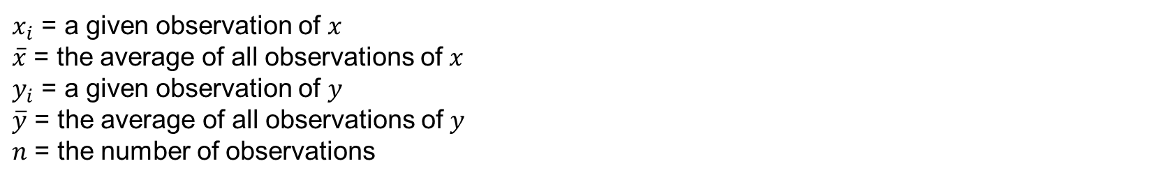

Foundations of Statistical Analysis
What is covariance?
Covariance: The tendency for two variables to change (covary) together
Math
(derived from eq. 2.3.4)
Cov(x,y) = $\frac{\sum{(x_{i}−\overline{x})(y_{i}−\overline{y})}}{n−1}$
$x_{i}$ = a given observation of $x_{ }$ $\overline{x}$ = the average of all observations of $x_{ }$ $y_{i}$ = a given observation of $y_{ }$ $\overline{y}$ = the average of all observations of $y_{ }$ $n$ = the number of observations

Slide 39
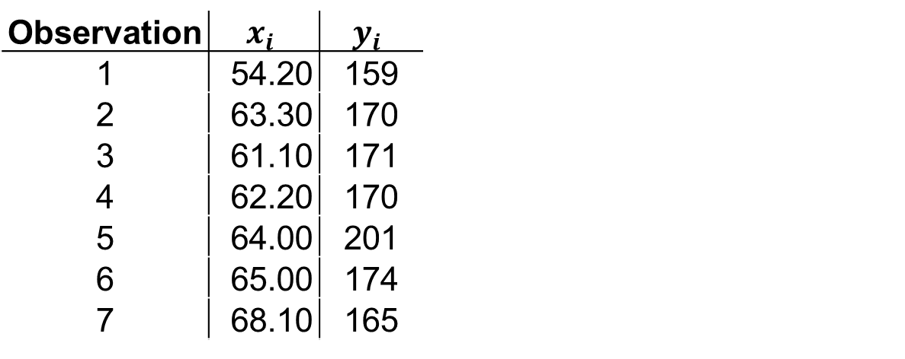
Foundations of Statistical Analysis
What is covariance?
What does covariance look like in real data?
Observation | $$x_{i}$$ | $$y_{i}$$ | $$x_{i}−\overline{x}$$ | $$y_{i}−\overline{y}$$ | $$\left(x_{i}−\overline{x}\right)\left(y_{i}−\overline{y}\right)$$
1 | 54.20 | 159
2 | 63.30 | 170
3 | 61.10 | 171
4 | 62.20 | 170
5 | 64.00 | 201
6 | 65.00 | 174
7 | 68.10 | 165
Diet Dataset
diet.dat[1:7,c("weight6weeks")] # returns xi
mean(diet.dat[1:7,c("weight6weeks")]) # returns xbar
diet.dat[1:7,c("Height")] # returns yi
mean(diet.dat[1:7,c("Height")]) # returns ybar

Slide 40
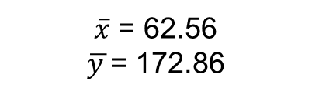
Foundations of Statistical Analysis
What is covariance?
What are the means of our x and y?
Observation | $$x_{i}$$ | $$y_{i}$$ | $$x_{i}−\overline{x}$$ | $$y_{i}−\overline{y}$$ | $$\left(x_{i}−\overline{x}\right)\left(y_{i}−\overline{y}\right)$$
1 | 54.20 | 159
2 | 63.30 | 170
3 | 61.10 | 171
4 | 62.20 | 170
5 | 64.00 | 201
6 | 65.00 | 174
7 | 68.10 | 165
$\overline{x}$ = 62.56
$\overline{y }$= 172.86
Diet Dataset
diet.dat[1:7,c("weight6weeks")] # returns xi
mean(diet.dat[1:7,c("weight6weeks")]) # returns xbar
diet.dat[1:7,c("Height")] # returns yi
mean(diet.dat[1:7,c("Height")]) # returns ybar

Slide 41
Foundations of Statistical Analysis
What is covariance?
What does covariance look like?
Observation | $$x_{i}$$ | $$y_{i}$$ | $$x_{i}−\overline{x}$$ | $$y_{i}−\overline{y}$$ | $$\left(x_{i}−\overline{x}\right)\left(y_{i}−\overline{y}\right)$$
1 | 54.20 | 159
2 | 63.30 | 170
3 | 61.10 | 171
4 | 62.20 | 170
5 | 64.00 | 201
6 | 65.00 | 174
7 | 68.10 | 165
Height (inches)
Diet Dataset
Weight (lbs)
diet.dat[1:7,c("weight6weeks")] # returns xi
mean(diet.dat[1:7,c("weight6weeks")]) # returns xbar
diet.dat[1:7,c("Height")] # returns yi
mean(diet.dat[1:7,c("Height")]) # returns ybar

Slide 42


Foundations of Statistical Analysis
What is covariance?
$\overline{x}$ = 62.56 lbs
What does covariance look like?
Observation | $$x_{i}$$ | $$y_{i}$$ | $$x_{i}−\overline{x}$$ | $$y_{i}−\overline{y}$$ | $$\left(x_{i}−\overline{x}\right)\left(y_{i}−\overline{y}\right)$$
1 | 54.20 | 159
2 | 63.30 | 170
3 | 61.10 | 171
4 | 62.20 | 170
5 | 64.00 | 201
6 | 65.00 | 174
7 | 68.10 | 165
$\overline{y }$= 172.86 inch
Height (inches)
Diet Dataset
Weight (lbs)
diet.dat[1:7,c("weight6weeks")] # returns xi
mean(diet.dat[1:7,c("weight6weeks")]) # returns xbar
diet.dat[1:7,c("Height")] # returns yi
mean(diet.dat[1:7,c("Height")]) # returns ybar

Slide 43
Foundations of Statistical Analysis
What is covariance?
$\overline{x}$ = 62.56 lbs
What does covariance look like?
Observation | $$x_{i}$$ | $$y_{i}$$ | $$x_{i}−\overline{x}$$ | $$y_{i}−\overline{y}$$ | $$\left(x_{i}−\overline{x}\right)\left(y_{i}−\overline{y}\right)$$
1 | 54.20 | 159
2 | 63.30 | 170
3 | 61.10 | 171
4 | 62.20 | 170
5 | 64.00 | 201
6 | 65.00 | 174
7 | 68.10 | 165
$\overline{y }$= 172.86 inch
Height (inches)
Diet Dataset
Weight (lbs)
diet.dat[1:7,c("weight6weeks")] # returns xi
mean(diet.dat[1:7,c("weight6weeks")]) # returns xbar
diet.dat[1:7,c("Height")] # returns yi
mean(diet.dat[1:7,c("Height")]) # returns ybar

Slide 44
Foundations of Statistical Analysis
What is covariance?
$\overline{x}$ = 62.56 lbs
What does covariance look like?
Observation | $$x_{i}$$ | $$y_{i}$$ | $$x_{i}−\overline{x}$$ | $$y_{i}−\overline{y}$$ | $$\left(x_{i}−\overline{x}\right)\left(y_{i}−\overline{y}\right)$$
1 | 54.20 | 159
2 | 63.30 | 170
3 | 61.10 | 171
4 | 62.20 | 170
5 | 64.00 | 201
6 | 65.00 | 174
7 | 68.10 | 165
$\overline{y }$= 172.86 inch
Height (inches)
Diet Dataset
Weight (lbs)
diet.dat[1:7,c("weight6weeks")] # returns xi
mean(diet.dat[1:7,c("weight6weeks")]) # returns xbar
diet.dat[1:7,c("Height")] # returns yi
mean(diet.dat[1:7,c("Height")]) # returns ybar

Slide 45
Foundations of Statistical Analysis
What is covariance?
$\overline{x}$ = 62.56 lbs
What does covariance look like?
Observation | $$x_{i}$$ | $$y_{i}$$ | $$x_{i}−\overline{x}$$ | $$y_{i}−\overline{y}$$ | $$\left(x_{i}−\overline{x}\right)\left(y_{i}−\overline{y}\right)$$
1 | 54.20 | 159
2 | 63.30 | 170
3 | 61.10 | 171
4 | 62.20 | 170
5 | 64.00 | 201
6 | 65.00 | 174
7 | 68.10 | 165
$\overline{y }$= 172.86 inch
Height (inches)
.
Diet Dataset
Weight (lbs)
diet.dat[1:7,c("weight6weeks")] # returns xi
mean(diet.dat[1:7,c("weight6weeks")]) # returns xbar
diet.dat[1:7,c("Height")] # returns yi
mean(diet.dat[1:7,c("Height")]) # returns ybar

Slide 46
Foundations of Statistical Analysis
What is covariance?
$\overline{x}$ = 62.56 lbs
What does covariance look like?
Observation | $$x_{i}$$ | $$y_{i}$$ | $$x_{i}−\overline{x}$$ | $$y_{i}−\overline{y}$$ | $$\left(x_{i}−\overline{x}\right)\left(y_{i}−\overline{y}\right)$$
1 | 54.20 | 159
2 | 63.30 | 170
3 | 61.10 | 171
4 | 62.20 | 170
5 | 64.00 | 201
6 | 65.00 | 174
7 | 68.10 | 165
$\overline{y }$= 172.86 inch
Height (inches)
.
.
Diet Dataset
Weight (lbs)
diet.dat[1:7,c("weight6weeks")] # returns xi
mean(diet.dat[1:7,c("weight6weeks")]) # returns xbar
diet.dat[1:7,c("Height")] # returns yi
mean(diet.dat[1:7,c("Height")]) # returns ybar

Slide 47
Foundations of Statistical Analysis
What is covariance?
$\overline{x}$ = 62.56 lbs
What does covariance look like?
Observation | $$x_{i}$$ | $$y_{i}$$ | $$x_{i}−\overline{x}$$ | $$y_{i}−\overline{y}$$ | $$\left(x_{i}−\overline{x}\right)\left(y_{i}−\overline{y}\right)$$
1 | 54.20 | 159
2 | 63.30 | 170
3 | 61.10 | 171
4 | 62.20 | 170
5 | 64.00 | 201
6 | 65.00 | 174
7 | 68.10 | 165
.
$\overline{y }$= 172.86 inch
Height (inches)
.
.
Diet Dataset
Weight (lbs)
diet.dat[1:7,c("weight6weeks")] # returns xi
mean(diet.dat[1:7,c("weight6weeks")]) # returns xbar
diet.dat[1:7,c("Height")] # returns yi
mean(diet.dat[1:7,c("Height")]) # returns ybar

Slide 48
Foundations of Statistical Analysis
What is covariance?
$\overline{x}$ = 62.56 lbs
What does covariance look like?
Observation | $$x_{i}$$ | $$y_{i}$$ | $$x_{i}−\overline{x}$$ | $$y_{i}−\overline{y}$$ | $$\left(x_{i}−\overline{x}\right)\left(y_{i}−\overline{y}\right)$$
1 | 54.20 | 159
2 | 63.30 | 170
3 | 61.10 | 171
4 | 62.20 | 170
5 | 64.00 | 201
6 | 65.00 | 174
7 | 68.10 | 165
.
$\overline{y }$= 172.86 inch
Height (inches)
.
.
.
Diet Dataset
Weight (lbs)
diet.dat[1:7,c("weight6weeks")] # returns xi
mean(diet.dat[1:7,c("weight6weeks")]) # returns xbar
diet.dat[1:7,c("Height")] # returns yi
mean(diet.dat[1:7,c("Height")]) # returns ybar

Slide 49
Foundations of Statistical Analysis
What is covariance?
.
$\overline{x}$ = 62.56 lbs
What does covariance look like?
Observation | $$x_{i}$$ | $$y_{i}$$ | $$x_{i}−\overline{x}$$ | $$y_{i}−\overline{y}$$ | $$\left(x_{i}−\overline{x}\right)\left(y_{i}−\overline{y}\right)$$
1 | 54.20 | 159
2 | 63.30 | 170
3 | 61.10 | 171
4 | 62.20 | 170
5 | 64.00 | 201
6 | 65.00 | 174
7 | 68.10 | 165
.
$\overline{y }$= 172.86 inch
Height (inches)
.
.
.
Diet Dataset
Weight (lbs)
diet.dat[1:7,c("weight6weeks")] # returns xi
mean(diet.dat[1:7,c("weight6weeks")]) # returns xbar
diet.dat[1:7,c("Height")] # returns yi
mean(diet.dat[1:7,c("Height")]) # returns ybar

Slide 50
Foundations of Statistical Analysis
What is covariance?
.
$\overline{x}$ = 62.56 lbs
What does covariance look like?
.
Observation | $$x_{i}$$ | $$y_{i}$$ | $$x_{i}−\overline{x}$$ | $$y_{i}−\overline{y}$$ | $$\left(x_{i}−\overline{x}\right)\left(y_{i}−\overline{y}\right)$$
1 | 54.20 | 159
2 | 63.30 | 170
3 | 61.10 | 171
4 | 62.20 | 170
5 | 64.00 | 201
6 | 65.00 | 174
7 | 68.10 | 165
.
$\overline{y }$= 172.86 inch
Height (inches)
.
.
.
Diet Dataset
Weight (lbs)
diet.dat[1:7,c("weight6weeks")] # returns xi
mean(diet.dat[1:7,c("weight6weeks")]) # returns xbar
diet.dat[1:7,c("Height")] # returns yi
mean(diet.dat[1:7,c("Height")]) # returns ybar

Slide 51
Foundations of Statistical Analysis
What is covariance?
.
$\overline{x}$ = 62.56 lbs
What does covariance look like?
.
Observation | $$x_{i}$$ | $$y_{i}$$ | $$x_{i}−\overline{x}$$ | $$y_{i}−\overline{y}$$ | $$\left(x_{i}−\overline{x}\right)\left(y_{i}−\overline{y}\right)$$
1 | 54.20 | 159
2 | 63.30 | 170
3 | 61.10 | 171
4 | 62.20 | 170
5 | 64.00 | 201
6 | 65.00 | 174
7 | 68.10 | 165
.
$\overline{y }$= 172.86 inch
Height (inches)
.
.
.
.
Diet Dataset
Weight (lbs)
diet.dat[1:7,c("weight6weeks")] # returns xi
mean(diet.dat[1:7,c("weight6weeks")]) # returns xbar
diet.dat[1:7,c("Height")] # returns yi
mean(diet.dat[1:7,c("Height")]) # returns ybar

Slide 52
Foundations of Statistical Analysis
What is covariance?
.
What does covariance look like?
.
Observation | $$x_{i}$$ | $$y_{i}$$ | $$x_{i}−\overline{x}$$ | $$y_{i}−\overline{y}$$ | $$\left(x_{i}−\overline{x}\right)\left(y_{i}−\overline{y}\right)$$
1 | 54.20 | 159
2 | 63.30 | 170
3 | 61.10 | 171
4 | 62.20 | 170
5 | 64.00 | 201
6 | 65.00 | 174
7 | 68.10 | 165
.
Height (cm)
.
.
.
.
Diet Dataset
Weight (kilos)
diet.dat[1:7,c("weight6weeks")] # returns xi
mean(diet.dat[1:7,c("weight6weeks")]) # returns xbar
diet.dat[1:7,c("Height")] # returns yi
mean(diet.dat[1:7,c("Height")]) # returns ybar

Slide 53
Foundations of Statistical Analysis
What is covariance?
.
What does covariance look like?
.
Observation | $$x_{i}$$ | $$y_{i}$$ | $$x_{i}−\overline{x}$$ | $$y_{i}−\overline{y}$$ | $$\left(x_{i}−\overline{x}\right)\left(y_{i}−\overline{y}\right)$$
1 | 54.20 | 159
2 | 63.30 | 170
3 | 61.10 | 171
4 | 62.20 | 170
5 | 64.00 | 201
6 | 65.00 | 174
7 | 68.10 | 165
.
Height (cm)
.
.
.
.
Diet Dataset
Weight (kilos)
diet.dat[1:7,c("weight6weeks")] # returns xi
mean(diet.dat[1:7,c("weight6weeks")]) # returns xbar
diet.dat[1:7,c("Height")] # returns yi
mean(diet.dat[1:7,c("Height")]) # returns ybar

Slide 54
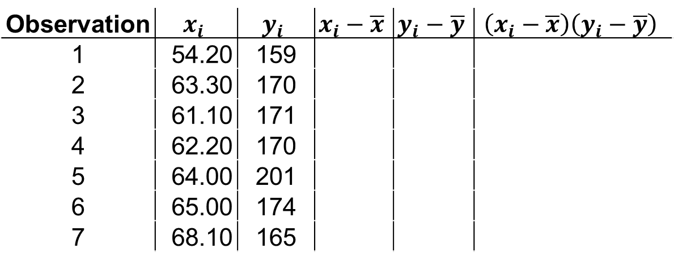
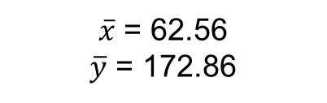
Foundations of Statistical Analysis
What is covariance?
How is covariance calculated?
Observation | $$x_{i}$$ | $$y_{i}$$ | $$x_{i}−\overline{x}$$ | $$y_{i}−\overline{y}$$ | $$\left(x_{i}−\overline{x}\right)\left(y_{i}−\overline{y}\right)$$
1 | 54.20 | 159
2 | 63.30 | 170
3 | 61.10 | 171
4 | 62.20 | 170
5 | 64.00 | 201
6 | 65.00 | 174
7 | 68.10 | 165
$\overline{x}$ = 62.56
$\overline{y}$ = 172.86
Diet Dataset

Slide 55
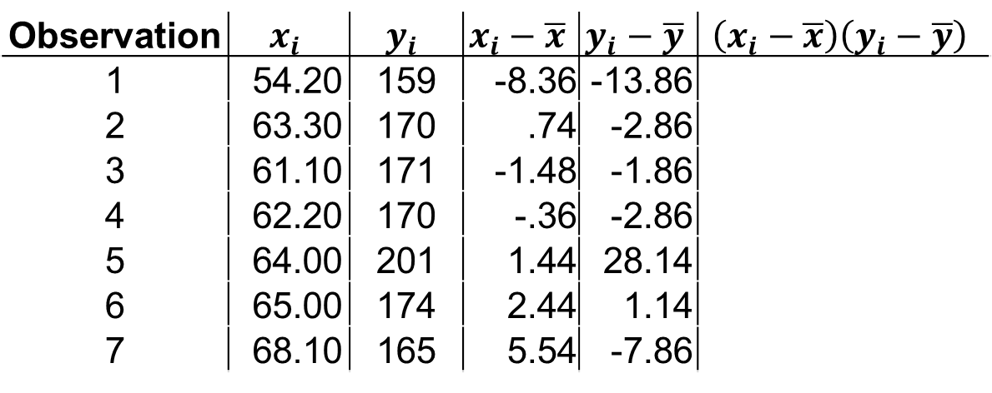
Foundations of Statistical Analysis
What is covariance?
Fill in the differences from the means
Observation | $$x_{i}$$ | $$y_{i}$$ | $$x_{i}−\overline{x}$$ | $$y_{i}−\overline{y}$$ | $$\left(x_{i}−\overline{x}\right)\left(y_{i}−\overline{y}\right)$$
1 | 54.20 | 159 | -8.36 | -13.86
2 | 63.30 | 170 | .74 | -2.86
3 | 61.10 | 171 | -1.48 | -1.86
4 | 62.20 | 170 | -.36 | -2.86
5 | 64.00 | 201 | 1.44 | 28.14
6 | 65.00 | 174 | 2.44 | 1.14
7 | 68.10 | 165 | 5.54 | -7.86
$\overline{x}$ = 62.56
$\overline{y}$ = 172.86
Diet Dataset
diet.dat[1:7,c("weight6weeks")]-mean(diet.dat[1:7,c("weight6weeks")]) # returns xi-xbar
diet.dat[1:7,c("Height")]-mean(diet.dat[1:7,c("Height")]) # returns yi-xbar

Slide 56
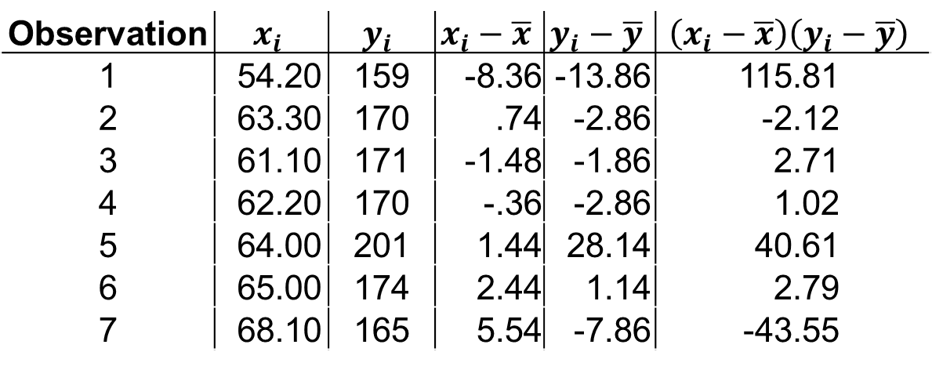
Foundations of Statistical Analysis
What is covariance?
Multiply the mean-differences
Observation | $$x_{i}$$ | $$y_{i}$$ | $$x_{i}−\overline{x}$$ | $$y_{i}−\overline{y}$$ | $$\left(x_{i}−\overline{x}\right)\left(y_{i}−\overline{y}\right)$$
1 | 54.20 | 159 | -8.36 | -13.86 | 115.81
2 | 63.30 | 170 | .74 | -2.86 | -2.12
3 | 61.10 | 171 | -1.48 | -1.86 | 2.71
4 | 62.20 | 170 | -.36 | -2.86 | 1.02
5 | 64.00 | 201 | 1.44 | 28.14 | 40.61
6 | 65.00 | 174 | 2.44 | 1.14 | 2.79
7 | 68.10 | 165 | 5.54 | -7.86 | -43.55
$\overline{x}$ = 62.56
$\overline{y}$ = 172.86
Diet Dataset
# Calculate the product of the mean differences
(diet.dat[1:7,c("weight6weeks")]-mean(diet.dat[1:7,c("weight6weeks")])) * (diet.dat[1:7,c("Height")]-mean(diet.dat[1:7,c("Height")]))

Slide 57
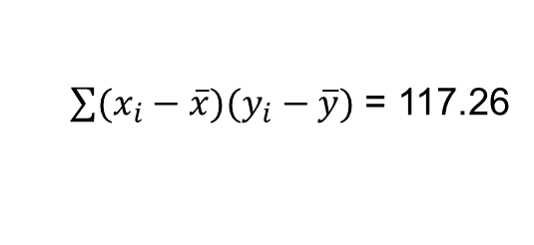
Foundations of Statistical Analysis
What is covariance?
Calculate the sum of the products
Observation | $$x_{i}$$ | $$y_{i}$$ | $$x_{i}−\overline{x}$$ | $$y_{i}−\overline{y}$$ | $$\left(x_{i}−\overline{x}\right)\left(y_{i}−\overline{y}\right)$$
1 | 54.20 | 159 | -8.36 | -13.86 | 115.81
2 | 63.30 | 170 | .74 | -2.86 | -2.12
3 | 61.10 | 171 | -1.48 | -1.86 | 2.71
4 | 62.20 | 170 | -.36 | -2.86 | 1.02
5 | 64.00 | 201 | 1.44 | 28.14 | 40.61
6 | 65.00 | 174 | 2.44 | 1.14 | 2.79
7 | 68.10 | 165 | 5.54 | -7.86 | -43.55
$\sum{(x_{i}−\overline{x})(y_{i}−\overline{y})}$ = 117.26
Diet Dataset
# Calculate the sum of the product of the mean differences
sum((diet.dat[1:7,c("weight6weeks")]-mean(diet.dat[1:7,c("weight6weeks")])) * (diet.dat[1:7,c("Height")]-mean(diet.dat[1:7,c("Height")])))

Slide 58
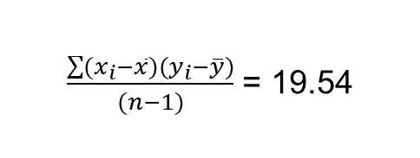
Foundations of Statistical Analysis
What is covariance?
Adjust by sample size
Observation | $$x_{i}$$ | $$y_{i}$$ | $$x_{i}−\overline{x}$$ | $$y_{i}−\overline{y}$$ | $$\left(x_{i}−\overline{x}\right)\left(y_{i}−\overline{y}\right)$$
1 | 54.20 | 159 | -8.36 | -13.86 | 115.81
2 | 63.30 | 170 | .74 | -2.86 | -2.12
3 | 61.10 | 171 | -1.48 | -1.86 | 2.71
4 | 62.20 | 170 | -.36 | -2.86 | 1.02
5 | 64.00 | 201 | 1.44 | 28.14 | 40.61
6 | 65.00 | 174 | 2.44 | 1.14 | 2.79
7 | 68.10 | 165 | 5.54 | -7.86 | -43.55
$\frac{\sum{(x_{i}−\overline{x})(y_{i}−\overline{y})}}{(n−1)}$ = 19.54
Diet Dataset
# Adjust for sample size (n-1)
sum((diet.dat[1:7,c("weight6weeks")]-mean(diet.dat[1:7,c("weight6weeks")])) * (diet.dat[1:7,c("Height")]-mean(diet.dat[1:7,c("Height")])))/(7-1)

Slide 59
Foundations of Statistical Analysis
What is covariance?
Adjust by sample size
How would you interpret this number?
Observation | $$x_{i}$$ | $$y_{i}$$ | $$x_{i}−\overline{x}$$ | $$y_{i}−\overline{y}$$ | $$\left(x_{i}−\overline{x}\right)\left(y_{i}−\overline{y}\right)$$
1 | 54.20 | 159 | -8.36 | -13.86 | 115.81
2 | 63.30 | 170 | .74 | -2.86 | -2.12
3 | 61.10 | 171 | -1.48 | -1.86 | 2.71
4 | 62.20 | 170 | -.36 | -2.86 | 1.02
5 | 64.00 | 201 | 1.44 | 28.14 | 40.61
6 | 65.00 | 174 | 2.44 | 1.14 | 2.79
7 | 68.10 | 165 | 5.54 | -7.86 | -43.55
$\frac{\sum{(x_{i}−\overline{x})(y_{i}−\overline{y})}}{(n−1)}$ = 19.54
Diet Dataset
# Adjust for sample size (n-1)
sum((diet.dat[1:7,c("weight6weeks")]-mean(diet.dat[1:7,c("weight6weeks")])) * (diet.dat[1:7,c("Height")]-mean(diet.dat[1:7,c("Height")])))/(7-1)

Slide 60
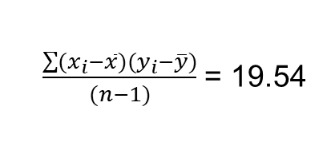
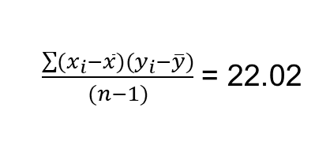
Foundations of Statistical Analysis
What is covariance?
How does this compare to the full sample?
Observation | $$x_{i}$$ | $$y_{i}$$ | $$x_{i}−\overline{x}$$ | $$y_{i}−\overline{y}$$ | $$\left(x_{i}−\overline{x}\right)\left(y_{i}−\overline{y}\right)$$
1 | 54.20 | 159 | -8.36 | -13.86 | 115.81
2 | 63.30 | 170 | .74 | -2.86 | -2.12
3 | 61.10 | 171 | -1.48 | -1.86 | 2.71
4 | 62.20 | 170 | -.36 | -2.86 | 1.02
5 | 64.00 | 201 | 1.44 | 28.14 | 40.61
6 | 65.00 | 174 | 2.44 | 1.14 | 2.79
7 | 68.10 | 165 | 5.54 | -7.86 | -43.55
Our calculation:
$\frac{\sum{(x_{i}−\overline{x})(y_{i}−\overline{y})}}{(n−1)}$ = 19.54
Full Sample calculation:
Diet Dataset
$\frac{\sum{(x_{i}−\overline{x})(y_{i}−\overline{y})}}{(n−1)}$ = 22.02
# Does this compare to the full dataset?
cov(diet.dat$weight6weeks, diet.dat$Height)

Slide 61
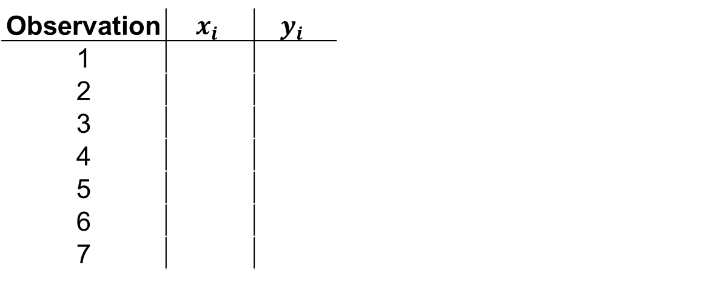

Foundations of Statistical Analysis
What is covariance?
What does covariance look like in our class dataset?
Observation | $$x_{i}$$ | $$y_{i}$$ | $$x_{i}−\overline{x}$$ | $$y_{i}−\overline{y}$$ | $$\left(x_{i}−\overline{x}\right)\left(y_{i}−\overline{y}\right)$$
1
2
3
4
5
6
7
$\overline{x}$ = ???
$\overline{y }$= ???
Class Dataset
dat$EmoLab # returns xi
mean(dat$EmoLab) # returns xbar
dat$Burnout # returns yi
mean(dat$Burnout) # returns ybar

Slide 62


Foundations of Statistical Analysis
What is covariance?
.
$$\overline{x}$$
What does covariance look like?
.
Observation | $$x_{i}$$ | $$y_{i}$$ | $$x_{i}−\overline{x}$$ | $$y_{i}−\overline{y}$$ | $$\left(x_{i}−\overline{x}\right)\left(y_{i}−\overline{y}\right)$$
1
2
3
4
5
6
7
.
$$\overline{y }$$
Burnout
.
.
.
.
Class Dataset
Emotional Exhaustion

Slide 63
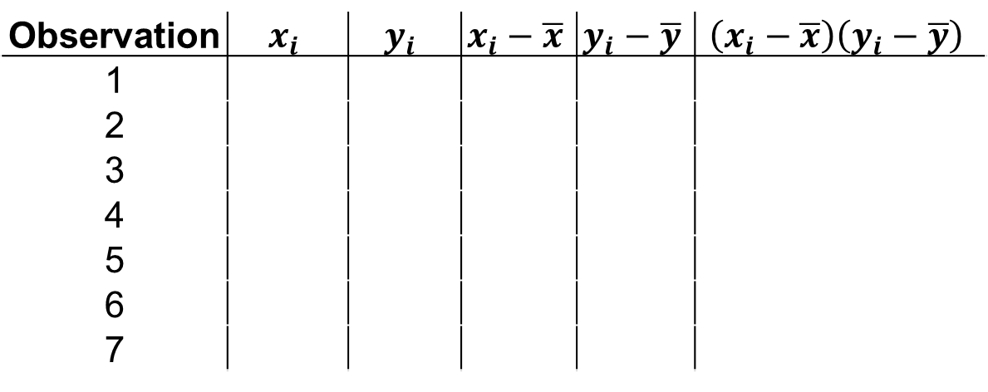

Foundations of Statistical Analysis
What is covariance?
Lets go through the calculation again
Observation | $$x_{i}$$ | $$y_{i}$$ | $$x_{i}−\overline{x}$$ | $$y_{i}−\overline{y}$$ | $$\left(x_{i}−\overline{x}\right)\left(y_{i}−\overline{y}\right)$$
1
2
3
4
5
6
7
$\overline{x}$ = ???
$\overline{y}$ = ???
Class Dataset

Slide 64
Foundations of Statistical Analysis
What is covariance?
Fill in the differences from the means
Observation | $$x_{i}$$ | $$y_{i}$$ | $$x_{i}−\overline{x}$$ | $$y_{i}−\overline{y}$$ | $$\left(x_{i}−\overline{x}\right)\left(y_{i}−\overline{y}\right)$$
1
2
3
4
5
6
7
$\overline{x}$ = ???
$\overline{y}$ = ???
Class Dataset
dat$EmoLab-mean(dat$EmoLab) # returns xi-xbar
dat$Burnout-mean(dat$Burnout) # returns yi-xbar

Slide 65
Foundations of Statistical Analysis
What is covariance?
Multiply the mean-differences
Observation | $$x_{i}$$ | $$y_{i}$$ | $$x_{i}−\overline{x}$$ | $$y_{i}−\overline{y}$$ | $$\left(x_{i}−\overline{x}\right)\left(y_{i}−\overline{y}\right)$$
1
2
3
4
5
6
7
Class Dataset
# Calculate the product of the mean differences
(dat$EmoLab-mean(dat$EmoLab)) * (dat$Burnout-mean(dat$Burnout))

Slide 66
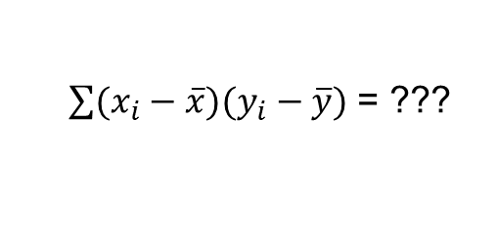
Foundations of Statistical Analysis
What is covariance?
Calculate the sum of the products
Observation | $$x_{i}$$ | $$y_{i}$$ | $$x_{i}−\overline{x}$$ | $$y_{i}−\overline{y}$$ | $$\left(x_{i}−\overline{x}\right)\left(y_{i}−\overline{y}\right)$$
1
2
3
4
5
6
7
$\sum{(x_{i}−\overline{x})(y_{i}−\overline{y})}$ = ???
Class Dataset
# Calculate the sum of the product of the mean differences
sum((dat$EmoLab-mean(dat$EmoLab)) * (dat$Burnout-mean(dat$Burnout)))

Slide 67
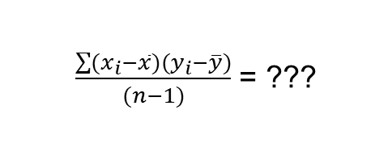
Foundations of Statistical Analysis
What is covariance?
Adjust by sample size
Observation | $$x_{i}$$ | $$y_{i}$$ | $$x_{i}−\overline{x}$$ | $$y_{i}−\overline{y}$$ | $$\left(x_{i}−\overline{x}\right)\left(y_{i}−\overline{y}\right)$$
1
2
3
4
5
6
7
$\frac{\sum{(x_{i}−\overline{x})(y_{i}−\overline{y})}}{(n−1)}$ = ???
Class Dataset
# Adjust for sample size (n-1)
sum((dat$EmoLab-mean(dat$EmoLab)) * (dat$Burnout-mean(dat$Burnout)))/(nrow(dat)-1)

Slide 68
Foundations of Statistical Analysis
What is covariance?
Adjust by sample size
How would you interpret this number?
Observation | $$x_{i}$$ | $$y_{i}$$ | $$x_{i}−\overline{x}$$ | $$y_{i}−\overline{y}$$ | $$\left(x_{i}−\overline{x}\right)\left(y_{i}−\overline{y}\right)$$
1
2
3
4
5
6
7
$\frac{\sum{(x_{i}−\overline{x})(y_{i}−\overline{y})}}{(n−1)}$ = ???
Class Dataset
# Adjust for sample size (n-1)
sum((dat$EmoLab-mean(dat$EmoLab)) * (dat$Burnout-mean(dat$Burnout)))/(nrow(dat)-1)

Slide 69
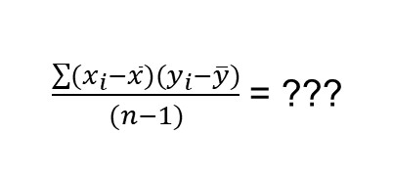
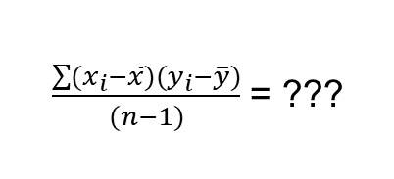
Foundations of Statistical Analysis
What is covariance?
How does this compare to the full sample?
Observation | $$x_{i}$$ | $$y_{i}$$ | $$x_{i}−\overline{x}$$ | $$y_{i}−\overline{y}$$ | $$\left(x_{i}−\overline{x}\right)\left(y_{i}−\overline{y}\right)$$
1
2
3
4
5
6
7
Our calculation:
$\frac{\sum{(x_{i}−\overline{x})(y_{i}−\overline{y})}}{(n−1)}$ = ???
Simulation calculation:
Class Dataset
$\frac{\sum{(x_{i}−\overline{x})(y_{i}−\overline{y})}}{(n−1)}$ = ???
# Does this compare to the simulated dataset?
cov(sim.dat$EmoLab, sim.dat$Burnout)

Slide 70
Foundations of Statistical Analysis
What is correlation?
What is a correlation?

Slide 71
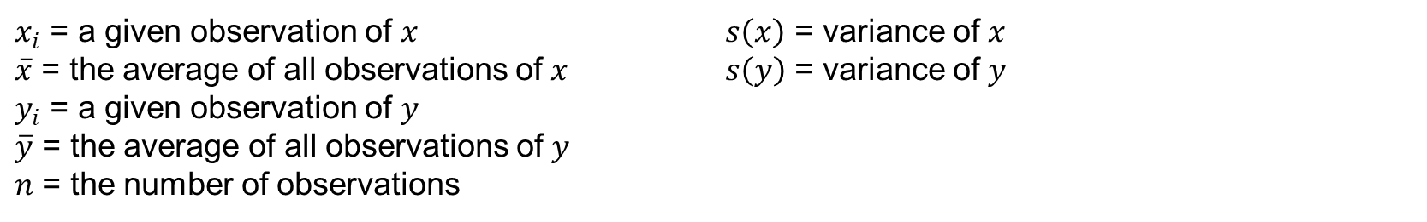
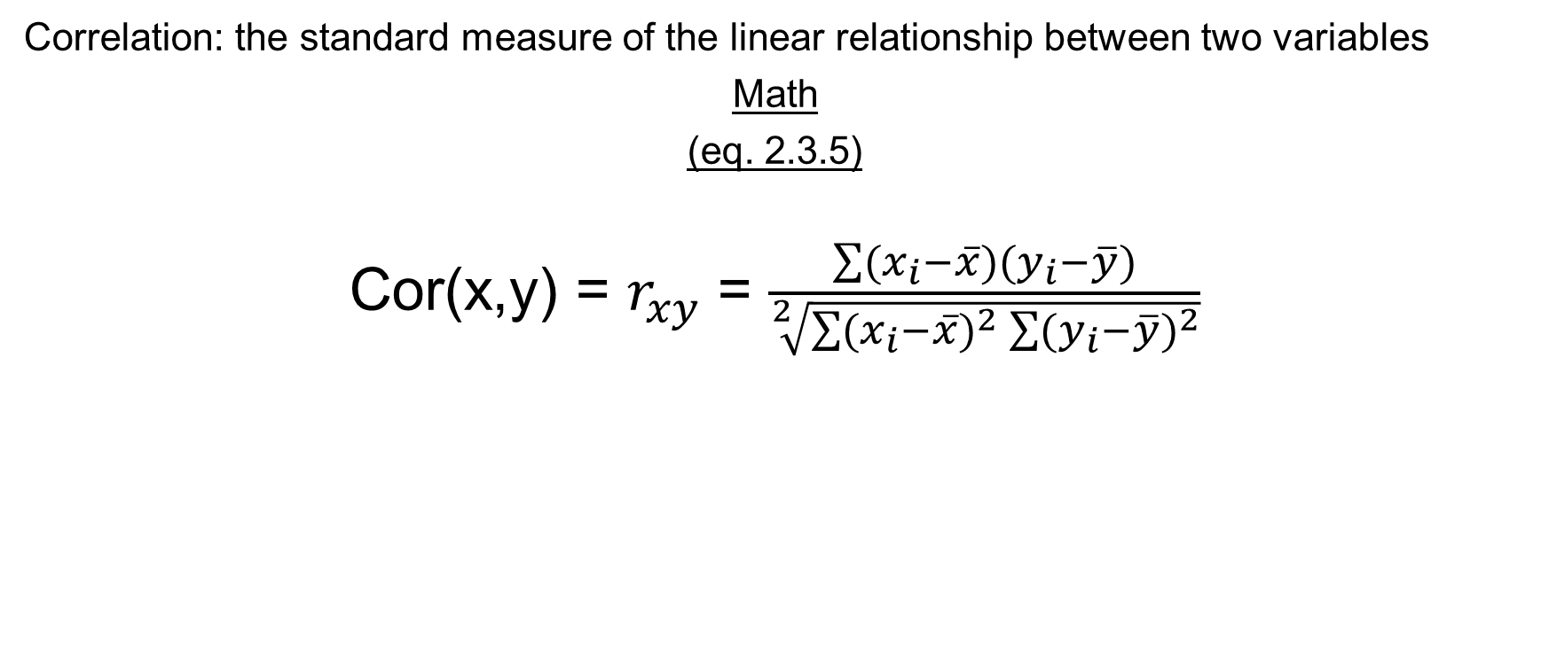
Foundations of Statistical Analysis
What is correlation?
Correlation: the standard measure of the linear relationship between two variables
Math
(eq. 2.3.5)
Cor(x,y) = $r_{xy}$ = $\frac{\sum{(x_{i}−\overline{x})(y_{i}−\overline{y})}}{\sqrt[2]{\sum{{(x_{i}−\overline{x})}^{2}}\sum{{(y_{i}−\overline{y})}^{2}}}}$
$x_{i}$ = a given observation of $x_{ }$ $\overline{x}$ = the average of all observations of $x_{ }$ $y_{i}$ = a given observation of $y_{ }$ $\overline{y}$ = the average of all observations of $y_{ }$ $n$ = the number of observations | $s\left(x\right)$ = variance of $x_{ }$ $s\left(y\right)$ = variance of $y_{ }$

Slide 72
Foundations of Statistical Analysis
What is correlation?
How is correlation calculated?
Observation | $$x_{i}$$ | $$y_{i}$$ | $$x_{i}−\overline{x}$$ | $$y_{i}−\overline{y}$$ | $$\left(x_{i}−\overline{x}\right)\left(y_{i}−\overline{y}\right)$$
1 | 54.20 | 159
2 | 63.30 | 170
3 | 61.10 | 171
4 | 62.20 | 170
5 | 64.00 | 201
6 | 65.00 | 174
7 | 68.10 | 165
$\overline{x}$ = 62.56
$\overline{y}$ = 172.86
Diet Dataset
diet.dat[1:7,c("weight6weeks")] # returns xi
mean(diet.dat[1:7,c("weight6weeks")]) # returns xbar
diet.dat[1:7,c("Height")] # returns yi
mean(diet.dat[1:7,c("Height")]) # returns ybar

Slide 73
Foundations of Statistical Analysis
What is correlation?
Fill in the differences from the means
Observation | $$x_{i}$$ | $$y_{i}$$ | $$x_{i}−\overline{x}$$ | $$y_{i}−\overline{y}$$ | $$\left(x_{i}−\overline{x}\right)\left(y_{i}−\overline{y}\right)$$
1 | 54.20 | 159 | -8.36 | -13.86
2 | 63.30 | 170 | .74 | -2.86
3 | 61.10 | 171 | -1.48 | -1.86
4 | 62.20 | 170 | -.36 | -2.86
5 | 64.00 | 201 | 1.44 | 28.14
6 | 65.00 | 174 | 2.44 | 1.14
7 | 68.10 | 165 | 5.54 | -7.86
$\overline{x}$ = 62.56
$\overline{y}$ = 172.86
Diet Dataset
diet.dat[1:7,c("weight6weeks")]-mean(diet.dat[1:7,c("weight6weeks")]) # returns xi-xbar
diet.dat[1:7,c("Height")]-mean(diet.dat[1:7,c("Height")]) # returns yi-xbar

Slide 74
Foundations of Statistical Analysis
What is correlation?
Multiply the mean-differences
Observation | $$x_{i}$$ | $$y_{i}$$ | $$x_{i}−\overline{x}$$ | $$y_{i}−\overline{y}$$ | $$\left(x_{i}−\overline{x}\right)\left(y_{i}−\overline{y}\right)$$
1 | 54.20 | 159 | -8.36 | -13.86 | 115.81
2 | 63.30 | 170 | .74 | -2.86 | -2.12
3 | 61.10 | 171 | -1.48 | -1.86 | 2.71
4 | 62.20 | 170 | -.36 | -2.86 | 1.02
5 | 64.00 | 201 | 1.44 | 28.14 | 40.61
6 | 65.00 | 174 | 2.44 | 1.14 | 2.79
7 | 68.10 | 165 | 5.54 | -7.86 | -43.55
Diet Dataset
# Calculate the product of the mean differences
(diet.dat[1:7,c("weight6weeks")]-mean(diet.dat[1:7,c("weight6weeks")])) * (diet.dat[1:7,c("Height")]-mean(diet.dat[1:7,c("Height")]))

Slide 75
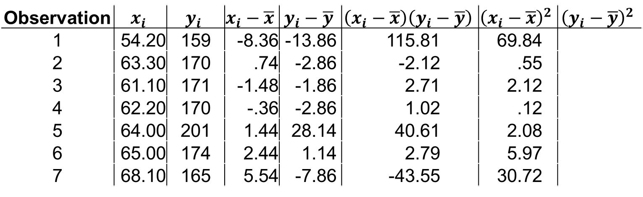
Foundations of Statistical Analysis
What is correlation?
Multiply the mean-differences
Observation | $$x_{i}$$ | $$y_{i}$$ | $$x_{i}−\overline{x}$$ | $$y_{i}−\overline{y}$$ | $$\left(x_{i}−\overline{x}\right)\left(y_{i}−\overline{y}\right)$$ | $${\left(x_{i}−\overline{x}\right)}^{2}$$ | $${\left(y_{i}−\overline{y}\right)}^{2}$$
1 | 54.20 | 159 | -8.36 | -13.86 | 115.81 | 69.84
2 | 63.30 | 170 | .74 | -2.86 | -2.12 | .55
3 | 61.10 | 171 | -1.48 | -1.86 | 2.71 | 2.12
4 | 62.20 | 170 | -.36 | -2.86 | 1.02 | .12
5 | 64.00 | 201 | 1.44 | 28.14 | 40.61 | 2.08
6 | 65.00 | 174 | 2.44 | 1.14 | 2.79 | 5.97
7 | 68.10 | 165 | 5.54 | -7.86 | -43.55 | 30.72
Diet Dataset
# Calculate the product of the mean differences
(diet.dat[1:7,c("weight6weeks")]-mean(diet.dat[1:7,c("weight6weeks")])) * (diet.dat[1:7,c("Height")]-mean(diet.dat[1:7,c("Height")]))

Slide 76
Foundations of Statistical Analysis
What is correlation?
Multiply the mean-differences
Observation | $$x_{i}$$ | $$y_{i}$$ | $$x_{i}−\overline{x}$$ | $$y_{i}−\overline{y}$$ | $$\left(x_{i}−\overline{x}\right)\left(y_{i}−\overline{y}\right)$$ | $${\left(x_{i}−\overline{x}\right)}^{2}$$ | $${\left(y_{i}−\overline{y}\right)}^{2}$$
1 | 54.20 | 159 | -8.36 | -13.86 | 115.81 | 69.84
2 | 63.30 | 170 | .74 | -2.86 | -2.12 | .55
3 | 61.10 | 171 | -1.48 | -1.86 | 2.71 | 2.12
4 | 62.20 | 170 | -.36 | -2.86 | 1.02 | .12
5 | 64.00 | 201 | 1.44 | 28.14 | 40.61 | 2.08
6 | 65.00 | 174 | 2.44 | 1.14 | 2.79 | 5.97
7 | 68.10 | 165 | 5.54 | -7.86 | -43.55 | 30.72
Diet Dataset
# Calculate the product of the mean differences
(diet.dat[1:7,c("weight6weeks")]-mean(diet.dat[1:7,c("weight6weeks")])) * (diet.dat[1:7,c("Height")]-mean(diet.dat[1:7,c("Height")]))

Slide 77
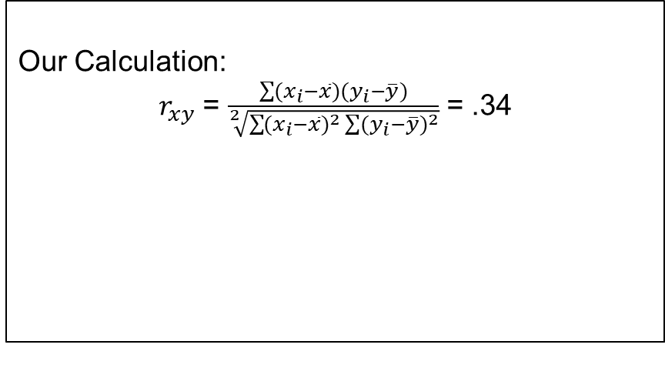
Foundations of Statistical Analysis
What is correlation?
Multiply the mean-differences
Our Calculation:
$r_{xy}$ = $\frac{\sum{(x_{i}−\overline{x})(y_{i}−\overline{y})}}{\sqrt[2]{\sum{{(x_{i}−\overline{x})}^{2}}\sum{{(y_{i}−\overline{y})}^{2}}}}$ = .34
Full Sample Calculation:
$r_{xy}$ = $\frac{\sum{(x_{i}−\overline{x})(y_{i}−\overline{y})}}{\sqrt[2]{\sum{{(x_{i}−\overline{x})}^{2}}\sum{{(y_{i}−\overline{y})}^{2}}}}$ = XXXX
Observation | $$x_{i}$$ | $$y_{i}$$ | $$x_{i}−\overline{x}$$ | $$y_{i}−\overline{y}$$ | $$\left(x_{i}−\overline{x}\right)\left(y_{i}−\overline{y}\right)$$ | $${\left(x_{i}−\overline{x}\right)}^{2}$$ | $${\left(y_{i}−\overline{y}\right)}^{2}$$
1 | 54.20 | 159 | -8.36 | -13.86 | 115.81 | 69.84
2 | 63.30 | 170 | .74 | -2.86 | -2.12 | .55
3 | 61.10 | 171 | -1.48 | -1.86 | 2.71 | 2.12
4 | 62.20 | 170 | -.36 | -2.86 | 1.02 | .12
5 | 64.00 | 201 | 1.44 | 28.14 | 40.61 | 2.08
6 | 65.00 | 174 | 2.44 | 1.14 | 2.79 | 5.97
7 | 68.10 | 165 | 5.54 | -7.86 | -43.55 | 30.72
Diet Dataset
# Calculate the product of the mean differences
(diet.dat[1:7,c("weight6weeks")]-mean(diet.dat[1:7,c("weight6weeks")])) * (diet.dat[1:7,c("Height")]-mean(diet.dat[1:7,c("Height")]))

Slide 78
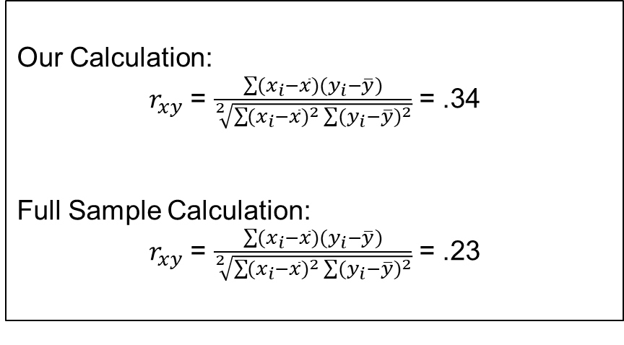
Foundations of Statistical Analysis
What is correlation?
Multiply the mean-differences
Our Calculation:
$r_{xy}$ = $\frac{\sum{(x_{i}−\overline{x})(y_{i}−\overline{y})}}{\sqrt[2]{\sum{{(x_{i}−\overline{x})}^{2}}\sum{{(y_{i}−\overline{y})}^{2}}}}$ = .34
Full Sample Calculation:
$r_{xy}$ = $\frac{\sum{(x_{i}−\overline{x})(y_{i}−\overline{y})}}{\sqrt[2]{\sum{{(x_{i}−\overline{x})}^{2}}\sum{{(y_{i}−\overline{y})}^{2}}}}$ = .23
Observation | $$x_{i}$$ | $$y_{i}$$ | $$x_{i}−\overline{x}$$ | $$y_{i}−\overline{y}$$ | $$\left(x_{i}−\overline{x}\right)\left(y_{i}−\overline{y}\right)$$ | $${\left(x_{i}−\overline{x}\right)}^{2}$$ | $${\left(y_{i}−\overline{y}\right)}^{2}$$
1 | 54.20 | 159 | -8.36 | -13.86 | 115.81 | 69.84
2 | 63.30 | 170 | .74 | -2.86 | -2.12 | .55
3 | 61.10 | 171 | -1.48 | -1.86 | 2.71 | 2.12
4 | 62.20 | 170 | -.36 | -2.86 | 1.02 | .12
5 | 64.00 | 201 | 1.44 | 28.14 | 40.61 | 2.08
6 | 65.00 | 174 | 2.44 | 1.14 | 2.79 | 5.97
7 | 68.10 | 165 | 5.54 | -7.86 | -43.55 | 30.72
Diet Dataset
# Calculate the product of the mean differences
(diet.dat[1:7,c("weight6weeks")]-mean(diet.dat[1:7,c("weight6weeks")])) * (diet.dat[1:7,c("Height")]-mean(diet.dat[1:7,c("Height")]))

Slide 79
Foundations of Statistical Analysis
What is covariance?
What does correlation look like?
Observation | $$x_{i}$$ | $$y_{i}$$ | $$x_{i}−\overline{x}$$ | $$y_{i}−\overline{y}$$ | $$\left(x_{i}−\overline{x}\right)\left(y_{i}−\overline{y}\right)$$
1 | 54.20 | 159
2 | 63.30 | 170
3 | 61.10 | 171
4 | 62.20 | 170
5 | 64.00 | 201
6 | 65.00 | 174
7 | 68.10 | 165
Height
Diet Dataset
Weight
diet.dat[1:7,c("weight6weeks")] # returns xi
mean(diet.dat[1:7,c("weight6weeks")]) # returns xbar
diet.dat[1:7,c("Height")] # returns yi
mean(diet.dat[1:7,c("Height")]) # returns ybar

Slide 80
Foundations of Statistical Analysis
What is covariance?
.
What does correlation look like?
.
Observation | $$x_{i}$$ | $$y_{i}$$ | $$x_{i}−\overline{x}$$ | $$y_{i}−\overline{y}$$ | $$\left(x_{i}−\overline{x}\right)\left(y_{i}−\overline{y}\right)$$
1 | 54.20 | 159
2 | 63.30 | 170
3 | 61.10 | 171
4 | 62.20 | 170
5 | 64.00 | 201
6 | 65.00 | 174
7 | 68.10 | 165
.
Height
.
.
.
.
Diet Dataset
Weight
diet.dat[1:7,c("weight6weeks")] # returns xi
mean(diet.dat[1:7,c("weight6weeks")]) # returns xbar
diet.dat[1:7,c("Height")] # returns yi
mean(diet.dat[1:7,c("Height")]) # returns ybar

Slide 81
Foundations of Statistical Analysis
What is covariance?
.
How is this different from covariance?
What does correlation look like?
.
Observation | $$x_{i}$$ | $$y_{i}$$ | $$x_{i}−\overline{x}$$ | $$y_{i}−\overline{y}$$ | $$\left(x_{i}−\overline{x}\right)\left(y_{i}−\overline{y}\right)$$
1 | 54.20 | 159
2 | 63.30 | 170
3 | 61.10 | 171
4 | 62.20 | 170
5 | 64.00 | 201
6 | 65.00 | 174
7 | 68.10 | 165
.
Height
.
.
.
.
Diet Dataset
Weight
diet.dat[1:7,c("weight6weeks")] # returns xi
mean(diet.dat[1:7,c("weight6weeks")]) # returns xbar
diet.dat[1:7,c("Height")] # returns yi
mean(diet.dat[1:7,c("Height")]) # returns ybar

Slide 82
Foundations of Statistical Analysis
What is correlation?
Calculate the correlation from our class data!
Class Dataset

Slide 83
Regression Analysis
83

Slide 84
Basic Regression
What is regression?
What is regression?

Slide 85
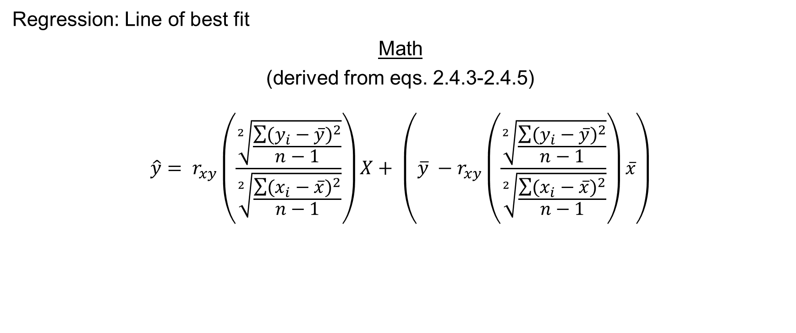
Basic Regression
What is regression?
Regression: Line of best fit
Math
(derived from eqs. 2.4.3-2.4.5)
$$\hat{y}= r_{xy}\left(\frac{\sqrt[2]{\frac{\sum{{(y_{i}−\overline{y})}^{2}}}{n−1}}}{\sqrt[2]{\frac{\sum{{(x_{i}−\overline{x})}^{2}}}{n−1}}}\right)X+ \left(\overline{y} −r_{xy}\left(\frac{\sqrt[2]{\frac{\sum{{(y_{i}−\overline{y})}^{2}}}{n−1}}}{\sqrt[2]{\frac{\sum{{(x_{i}−\overline{x})}^{2}}}{n−1}}}\right)\overline{x}\right)$$
$x_{i}$ = a given observation of $x_{ }$ $\overline{x}$ = the average of all observations of $x_{ }$ $y_{i}$ = a given observation of $y_{ }$ $\overline{y}$ = the average of all observations of $y_{ }$ $n$ = the number of observations | $s\left(x\right)$ = variance of $x_{ }$ $s\left(y\right)$ = variance of $y_{ }$

Slide 86

Basic Regression
What is regression?
Math
$$\hat{y}= r_{xy}\left(\frac{\sqrt[2]{\frac{\sum{{(y_{i}−\overline{y})}^{2}}}{n−1}}}{\sqrt[2]{\frac{\sum{{(x_{i}−\overline{x})}^{2}}}{n−1}}}\right)X+ \left(\overline{y} −r_{xy}\left(\frac{\sqrt[2]{\frac{\sum{{(y_{i}−\overline{y})}^{2}}}{n−1}}}{\sqrt[2]{\frac{\sum{{(x_{i}−\overline{x})}^{2}}}{n−1}}}\right)\overline{x}\right)$$
Standard Deviation of Y

Slide 87

Basic Regression
What is regression?
Math
$$\hat{y}= r_{xy}\left(\frac{{sd}_{y}}{\sqrt[2]{\frac{\sum{{(x_{i}−\overline{x})}^{2}}}{n−1}}}\right)X+ \left(\overline{y} −r_{xy}\left(\frac{{sd}_{y}}{\sqrt[2]{\frac{\sum{{(x_{i}−\overline{x})}^{2}}}{n−1}}}\right)\overline{x}\right)$$
Standard Deviation of X

Slide 88
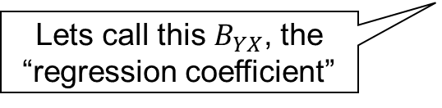

Basic Regression
What is regression?
Math
$$\hat{y}= r_{xy}\left(\frac{{sd}_{y}}{{sd}_{x}}\right)\overline{x}+ \left(\overline{y} −r_{xy}\left(\frac{{sd}_{y}}{{sd}_{x}}\right)\overline{x}\right)$$
Lets call this $B_{YX}$, the “regression coefficient”

Slide 89
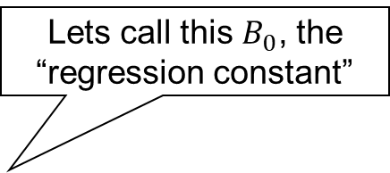

Basic Regression
What is regression?
Math
$$\hat{y}= B_{yx}X+ \left(\overline{y} −r_{xy}\left(\frac{{sd}_{y}}{{sd}_{x}}\right)\overline{x}\right)$$
Lets call this $B_{0}$, the “regression constant”

Slide 90

Basic Regression
What is regression?
Math
(eq. 2.4.5)
$$\hat{y}= B_{yx}X+ B_{0}$$

Slide 91

Basic Regression
What is regression?
Math
$$\hat{y}= B_{yx}X+ B_{0}$$
The rate of change in Y units per unit change in X

Slide 92
Basic Regression
What is regression?
Math
$$\hat{y}= B_{yx}X+ B_{0}$$
The Y Intercept
(adjusts for differences in size between X and Y units)

Slide 93

Basic Regression
What is regression?
Math
(eq. 2.4.6)
$$y= B_{YX}X+ B_{0}+e$$

Slide 94

Basic Regression
What is regression?
Math
$$y= B_{YX}X+ B_{0}+e$$
To estimate an exact value of Y, we add in an error term

Slide 95
Basic Regression
What is regression?
Math
$$y= B_{YX}X+ B_{0}+e$$
What if we want to expand out to multiple predictors?

Slide 96

Basic Regression
What is regression?
Math
$$y= B_{YX}X+B_{YZ}Z+ B_{0}+e$$

Slide 97

Basic Regression
What is regression?
Math
$$y= B_{YX}X+B_{YZ}Z+B_{YC}C+B_{0}+e$$

Slide 98

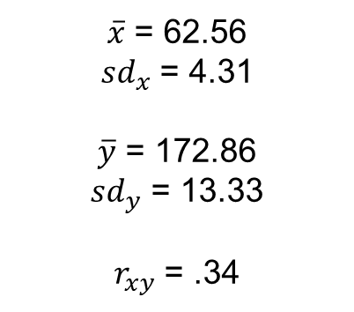
Foundations of Statistical Analysis
What is correlation?
How is regression calculated?
Observation | $$x_{i}$$ | $$y_{i}$$
1 | 54.20 | 159
2 | 63.30 | 170
3 | 61.10 | 171
4 | 62.20 | 170
5 | 64.00 | 201
6 | 65.00 | 174
7 | 68.10 | 165
$\overline{x}$ = 62.56
${sd}_{x}$ = 4.31
$\overline{y}$ = 172.86
${sd}_{y}$ = 13.33
$r_{xy}$ = .34
Diet Dataset
mean(diet.dat[1:7,c("weight6weeks")]) # returns xbar
sd(diet.dat[1:7,c("weight6weeks")]) # returns sdx
mean(diet.dat[1:7,c("Height")]) # returns ybar
sd(diet.dat[1:7,c("Height")]) # returns sdy
cor(diet.dat[1:7,c("weight6weeks")],diet.dat[1:7,c("Height")]) # returns rxy

Slide 99

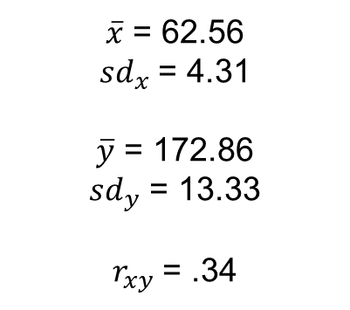
Foundations of Statistical Analysis
What is correlation?
How is regression calculated?
$\overline{x}$ = 62.56
${sd}_{x}$ = 4.31
$\overline{y}$ = 172.86
${sd}_{y}$ = 13.33
$r_{xy}$ = .34
$$B_{YX}= r_{xy}\left(\frac{{sd}_{y}}{{sd}_{x}}\right)$$
$$B_{0}=\overline{y} −r_{xy}\left(\frac{{sd}_{y}}{{sd}_{x}}\right)\overline{x}$$
Diet Dataset

Slide 100

Foundations of Statistical Analysis
What is correlation?
How is regression calculated?
$\overline{x}$ = 62.56
${sd}_{x}$ = 4.31
$\overline{y}$ = 172.86
${sd}_{y}$ = 13.33
$r_{xy}$ = .34
$$B_{YX}=(.34)\left(\frac{13.33}{4.31}\right)$$
$$B_{0}=(172.86) −(.34)\left(\frac{13.33}{4.31}\right)(62.56)$$
Diet Dataset

Slide 101

Foundations of Statistical Analysis
What is correlation?
How is regression calculated?
$\overline{x}$ = 62.56
${sd}_{x}$ = 4.31
$\overline{y}$ = 172.86
${sd}_{y}$ = 13.33
$r_{xy}$ = .34
$$B_{YX}=1.05$$
$$B_{0}=107.02$$
Diet Dataset
# Calculate Byx
cor(diet.dat[1:7,c("weight6weeks")],diet.dat[1:7,c("Height")]) * (sd(diet.dat[1:7,c("Height")]) / sd(diet.dat[1:7,c("weight6weeks")])) # rxy * (sdy/sdx)
# Calculate B0
mean(diet.dat[1:7,c("Height")]) - ((cor(diet.dat[1:7,c("weight6weeks")],diet.dat[1:7,c("Height")]) * (sd(diet.dat[1:7,c("Height")]) / sd(diet.dat[1:7,c("weight6weeks")]))) * mean(diet.dat[1:7,c("weight6weeks")])) #ybar -(rxy(sdy/sdx)*xbar)

Slide 102

Basic Regression
What is regression?
$$\hat{y}=1.05X+107.02$$
How is regression calculated?
Diet Dataset

Slide 103

Basic Regression
What is regression?
How is regression calculated?
$$\hat{y}=1.05X+107.02$$
150
Height
Diet Dataset
100
50
10
20
30
40
50
60
70
Weight

Slide 104
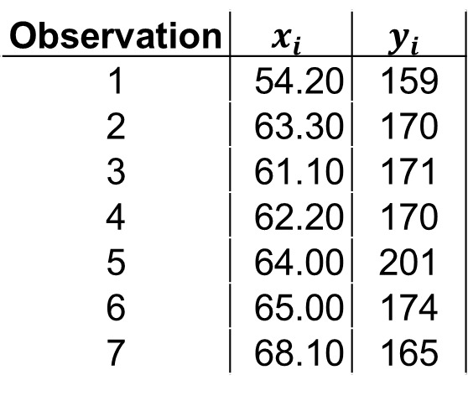

Basic Regression
What is regression?
How is regression calculated?
$$\hat{y}=1.05X+107.02$$
Observation | $$x_{i}$$ | $$y_{i}$$
1 | 54.20 | 159
2 | 63.30 | 170
3 | 61.10 | 171
4 | 62.20 | 170
5 | 64.00 | 201
6 | 65.00 | 174
7 | 68.10 | 165
150
Height
Diet Dataset
100
50
12
24
36
48
60
72
Weight

Slide 105
Basic Regression
What is regression?
.
How is regression calculated?
.
.
.
$$\hat{y}=1.05X+107.02$$
.
.
.
Observation | $$x_{i}$$ | $$y_{i}$$
1 | 54.20 | 159
2 | 63.30 | 170
3 | 61.10 | 171
4 | 62.20 | 170
5 | 64.00 | 201
6 | 65.00 | 174
7 | 68.10 | 165
150
Height
Diet Dataset
100
50
12
24
36
48
60
72
Weight

Slide 106
Basic Regression
What is regression?
.
How is regression calculated?
.
.
.
$$\hat{y}=1.05X+107.02$$
.
.
.
Observation | $$x_{i}$$ | $$y_{i}$$
1 | 54.20 | 159
2 | 63.30 | 170
3 | 61.10 | 171
4 | 62.20 | 170
5 | 64.00 | 201
6 | 65.00 | 174
7 | 68.10 | 165
150
What if we want to know the exact value of Y?
Height
Diet Dataset
100
50
12
24
36
48
60
72
Weight

Slide 107

Basic Regression
What is regression?
.
How is regression calculated?
.
.
.
Y $=1.05X+107.02+e$
.
.
.
Observation | $$x_{i}$$ | $$y_{i}$$
1 | 54.20 | 159
2 | 63.30 | 170
3 | 61.10 | 171
4 | 62.20 | 170
5 | 64.00 | 201
6 | 65.00 | 174
7 | 68.10 | 165
150
Height
Diet Dataset
100
50
12
24
36
48
60
72
Weight

Slide 108
Basic Regression
What is regression?
.
.
How is regression calculated?
.
.
.
.
.
.
.
.
.
.
Observation | $$x_{i}$$ | $$y_{i}$$
1 | 54.20 | 159
2 | 63.30 | 170
3 | 61.10 | 171
4 | 62.20 | 170
5 | 64.00 | 201
6 | 65.00 | 174
7 | 68.10 | 165
.
150
.
Height
Diet Dataset
100
50
12
24
36
48
60
72
Weight

Slide 109
Basic Regression
What is regression?
.
.
How is regression calculated?
.
.
.
.
.
.
.
.
.
.
Observation | $$x_{i}$$ | $$y_{i}$$
1 | 54.20 | 159
2 | 63.30 | 170
3 | 61.10 | 171
4 | 62.20 | 170
5 | 64.00 | 201
6 | 65.00 | 174
7 | 68.10 | 165
.
150
.
Height
Diet Dataset
100
50
12
24
36
48
60
72
Weight

Slide 110
Basic Regression
What is regression?
.
How is regression calculated?
.
.
.
.
.
.
Observation | $$x_{i}$$ | $$y_{i}$$
1 | 54.20 | 159
2 | 63.30 | 170
3 | 61.10 | 171
4 | 62.20 | 170
5 | 64.00 | 201
6 | 65.00 | 174
7 | 68.10 | 165
150
What is the problem with the clustering of this data?
Height
Diet Dataset
100
50
12
24
36
48
60
72
Weight

Slide 111
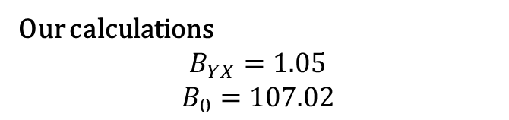
Basic Regression
What is regression?
.
How is regression calculated?
.
.
.
.
.
.
Our calculations
$$B_{YX}=1.05$$
$$B_{0}=107.02$$
150
Height
Diet Dataset
How do our calculation compare to the full data?
100
50
12
24
36
48
60
72
Weight

Slide 112

Basic Regression
What is regression?
.
How is regression calculated?
.
.
.
.
.
.
Our calculations
$$B_{YX}=1.05$$
$$B_{0}=107.02$$
Full Data calculations
$$B_{YX}=.34$$
$$B_{0}=148.03$$
150
Height
Diet Dataset
100
50
12
24
36
48
60
72
Weight

Slide 113

Foundations of Statistical Analysis
What is correlation?
Calculate the regression coefficient ($B_{yx}$) and regression constant ($B_{0}$) from our class data!
Class Dataset

